Slide 1
Endocrine System
aka, “the other” communication system
There is a lot of interaction between the neural and endocrine systems. Therefore, maybe better thought of as one half of the “Neuroendocrine System”

Slide 2
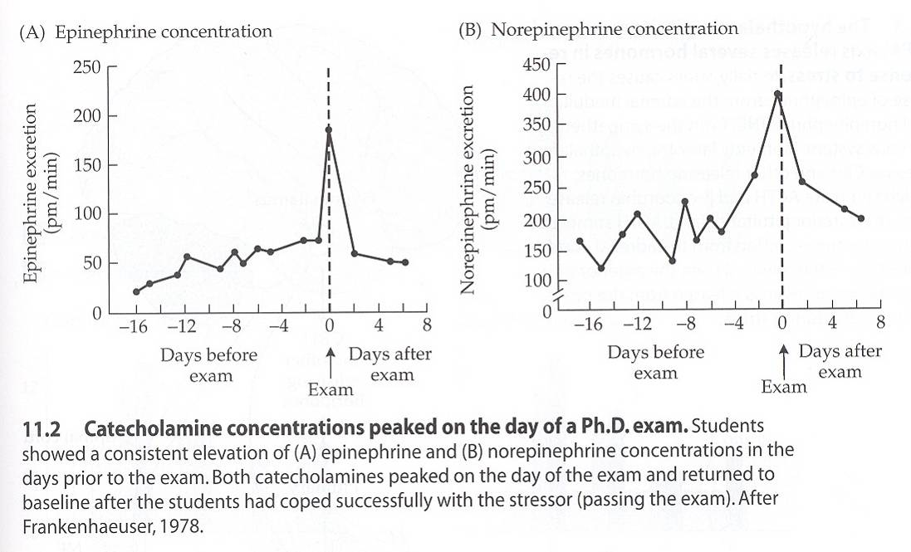
Evidence of Neuronendocrine Integration
Nelson 2005

Slide 3
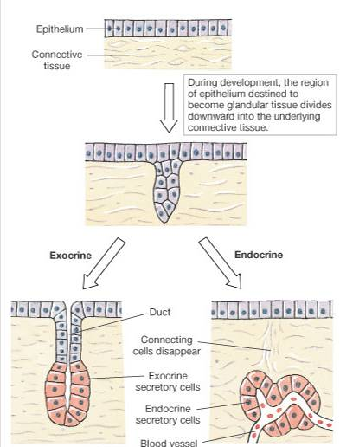
Organization
Not anatomically organized like many other systems.
What makes a hormone?
Many—but not all—hormones are secreted by endocrine glands

Slide 4
Organization
Many different tissue types secrete hormones.
  Refer to Table 11.1
  Refer to Handout
Several different chemical classes of hormones, too.

Slide 5
Hormone types
Amino acid derivatives (all from tyrosine)
Peptides, Proteins (most hormones)
Cholesterol derivatives—Steroids
  Produced by adrenal cortex, gonads, placenta

Slide 6
Similarities between Hormones and NTs
Chemical signals
Used in negative feedback
Bind to protein receptors at target
Binding follows rules of mass action
H-R complex → change in cell function
Can change the rate of target function
Graded response, stimulation and inhibition possible
Deactivated by enzymes
Tonic release of many hormones
Involved in down- and up-regulation of cell processes

Slide 7
If so similar, which one ‘makes sense’ to use?
Nervous Communication | Hormonal Communication
Rapid communication (msec) | Slow communication (sec)
Immediate on/off | Residual effects
Specific target | General target
Specific source | General source

Slide 8
Other differences between NTs and hormones
Many hormones are secreted as precursors
Many are secreted in cycles
Some circulate bound to plasma proteins
Hormone interactions are usually non-additive.
  So what are interactions like?

Slide 9
Hormone interactions
Tropic regulation
Influences secretion of other hormones
Ex.: Ant. Pituitary secretes TSH, which targets the thyroid and stimulates T₄ secretion. T₄ converted to T₃, which targets many tissues to affect growth, met. rate, brain dev.
Many hormones have strictly tropic effects.

Slide 10
Tropic versus Trophic
Tropic = affects secretion
Trophic = growth promoting
Some ‘tropic’ hormones also exhibit trophic effects on target glands.

Slide 11
Hormone interactions
Potentiation
Simultaneous influences of mult. hormones.
Synergistic effect:
  Net effect > ∑ individual effects
  Ex.: Epinephrine → adipocyte → small release of F.A.
  Thyroxine → adipocyte → no effect
  Epi. + Thyroxine → adipocyte → BIG release of F.A.

Slide 12
Epinephrine + Thyroxine
Fatty acid release
Epinephrine
Thyroxine
Time

Slide 13
Where are Hormone Receptors?
Intracellular receptors
  steroids and thyroid hormone
Membrane receptors
  pretty much everything else

Slide 14
Hormone Pools
wasted
Synthesis Pool
(gland or plasma) used

Slide 15
Hormone Secretion
Classic negative feed-back (usually)
Hormone expression is regulated by:
Ion or nutrient concentration in plasma
Neural stimulation
Other hormones
Phasic secretion for some
Tonic secretion for others

Slide 16
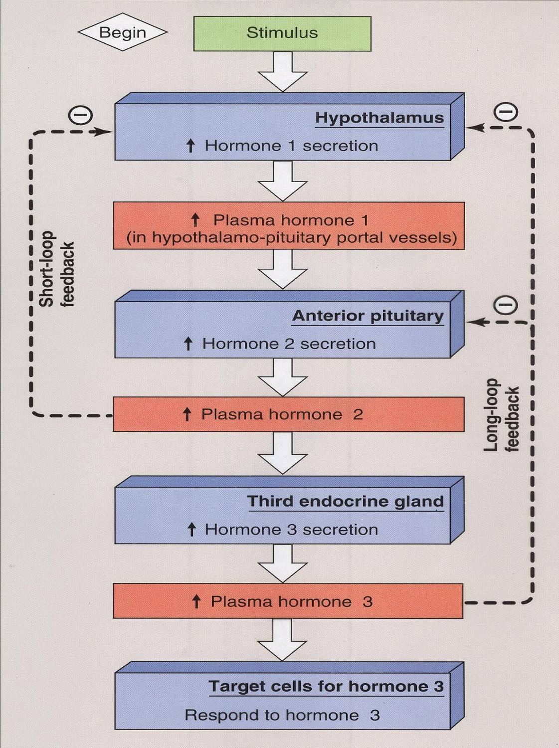
“Typical” Regulatory Pathway

